Slide 1
Analyzing Trade-offs in Reversible Linear and Binary Search Algorithms
Graduate Program of Software Engineering
Nanzan University
Hiroki Masuda
Tetsuo Yokoya

Slide 2
Scenario
Research Background
Challenges
Reversible Search
Reversible Linear Search
Reversible Binary Search
Conclusion
Rerated Works

Slide 3
1.Research Background
Reversible Algorithm
Forward and backward determinism in reversible systems
Applications
Parallel Discrete-Event Simulation
Quantum Circuit Synthesis and Design

Slide 4
2.Challenge
Goal
Optimization of Reversible Algorithm
Task
Construct of efficient reversible linear and binary search algorithms
Analyze of the trade-offs between the number of traversals of the input data and the memory usage

Slide 5
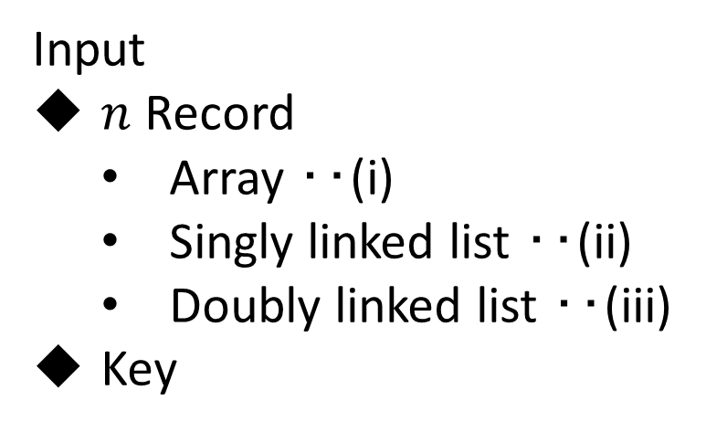
3.Reversible Search()
Search Problem
Find a record containing a given key in a collection of a file
Input
$n$ Record
  Array ‥(i)
  Singly linked list ‥(ii)
  Doubly linked list ‥(iii)
Key
Output
Flag ‥(a)
Number ‥(b)
Location ‥(c)

Slide 6

3.Reversible Search()
The useful criteria of reversible algorithms
$M_{1}$: The memory usage
$M_{2}$: The size of the garbage
(except for the original input and output)

Slide 7
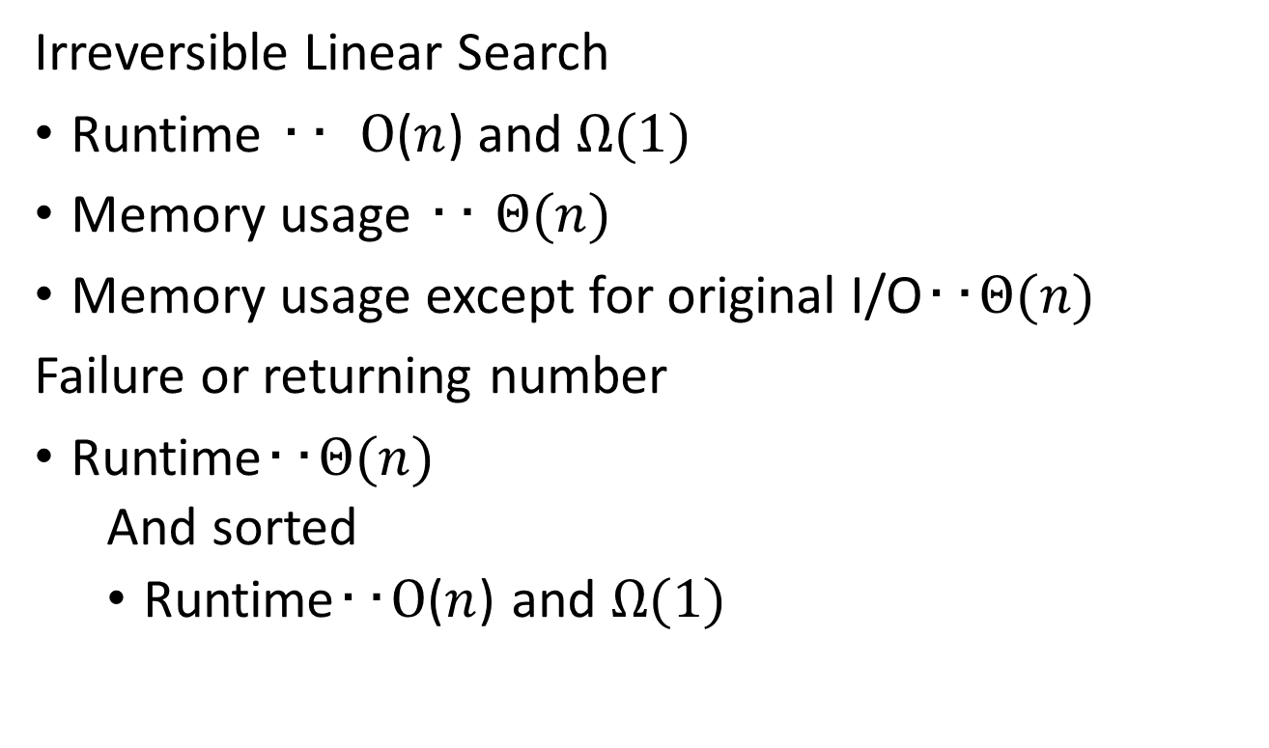
4.Reversible Linear Search()
Irreversible Linear Search
Runtime ‥ $Ο$($n$) and $Ω(1)$
Memory usage ‥ $Θ(n)$
Memory usage except for original I/O‥$Θ(n)$
Failure or returning number
Runtime‥$Θ(n)$
  And sorted
  Runtime‥$Ο$($n$) and $Ω(1)$

Slide 8
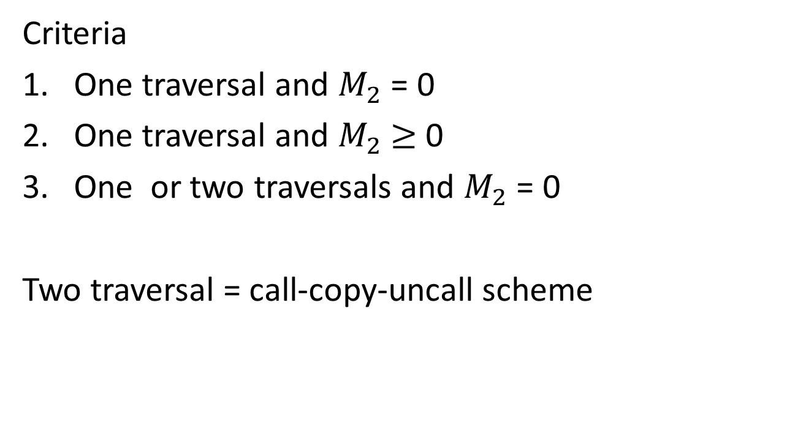
4.Reversible Linear Search()
Criteria
One traversal and $M_{2}$ = 0
One traversal and $M_{2}$ $≥$ 0
One or two traversals and $M_{2}$ = 0
Two traversal = call-copy-uncall scheme

Slide 9




4.Reversible Linear Search()
Doubly linked list
$$q$$
$$p$$
(1)
$$q$$
$$p$$
(2)

Slide 10
4.Reversible Linear Search()
Doubly linked list
$$q$$
$$p$$
(3)
$$q$$
$$p$$
(4)

Slide 11

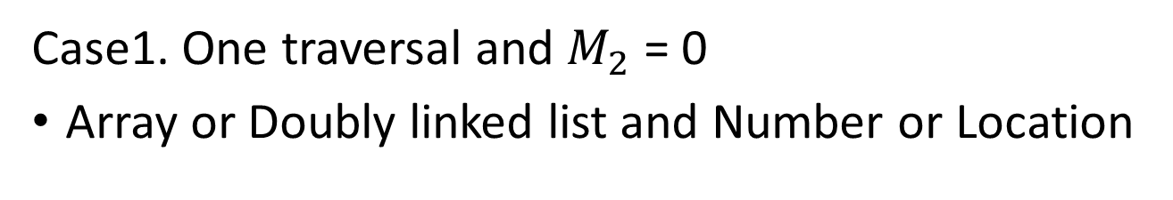

4.Reversible Linear Search()
Case1. One traversal and $M_{2}$ = 0
Array or Doubly linked list and Number or Location
Number
Output
$$R_{0}$$ | $$R_{1}$$ | $$R_{2}$$ | $$R_{3}$$ | $$R_{4}$$
$$n$$
STOP

Slide 12


4.Reversible Linear Search()
Case1. One traversal and $M_{2}$ = 0
Array or Doubly linked list and Number or Location
Location
Output
Success
$$R_{0}$$ | $$R_{1}$$ | $$R_{2}$$ | $$R_{3}$$ | $$R_{4}$$
$$R_{3}$$
Output
Failure
$$R_{0}$$ | $$R_{1}$$ | $$R_{2}$$ | $$R_{3}$$ | $$R_{4}$$
STOP
0

Slide 13
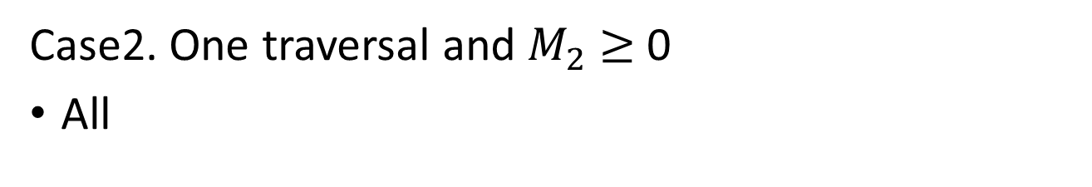
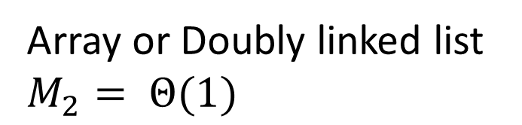
4.Reversible Linear Search()
Case2. One traversal and $M_{2}$ $≥$ 0
All
Array or Doubly linked list $M_{2}= Θ(1)$
Output
Garbage
$$R_{0}$$ | $$R_{1}$$ | $$R_{2}$$ | $$R_{3}$$ | $$R_{4}$$
$$R_{3}$$

Slide 14
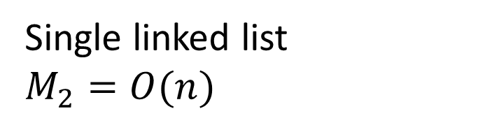
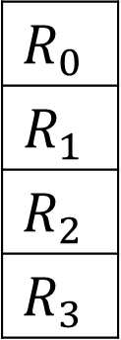
4.Reversible Linear Search()
Case2. One traversal and $M_{2}$ $≥$ 0
All
Single linked list
$M_{2}=O(n)$
Output
Garbage
Stack
$$R_{0}$$ | $$R_{1}$$ | $$R_{2}$$ | $$R_{3}$$ | $$R_{4}$$
$$R_{0}$$
$$R_{1}$$
$$R_{2}$$
$$R_{3}$$

Slide 15
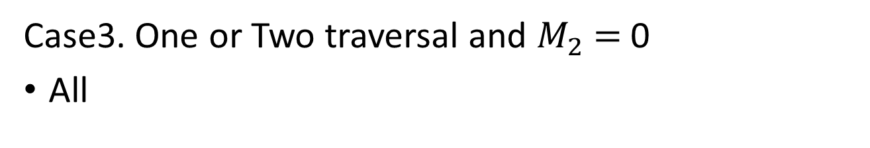
4.Reversible Linear Search()
Case3. One or Two traversal and $M_{2}$ $=$ 0
All
Flag
Output
Garbage
$$R_{0}$$ | $$R_{1}$$ | $$R_{2}$$ | $$R_{3}$$ | $$R_{4}$$
1
$$R_{3}$$
Output
Failure
$$R_{0}$$ | $$R_{1}$$ | $$R_{2}$$ | $$R_{3}$$ | $$R_{4}$$
STOP
0

Slide 16
4.Reversible Linear Search()
Case3. One or Two traversal and $M_{2}$ $=$ 0
All
Flag
Output
Garbage
$$R_{0}$$ | $$R_{1}$$ | $$R_{2}$$ | $$R_{3}$$ | $$R_{4}$$
1
Output
Failure
$$R_{0}$$ | $$R_{1}$$ | $$R_{2}$$ | $$R_{3}$$ | $$R_{4}$$
STOP
0

Slide 17

5.Reversible Binary Search()
Binary Search
Runtime $O(\log{n)}$

